Slide 1

NASI SPONSORZY I PARTNERZY

Slide 2
SQL Server 2014 to nie tylko In-Memory
Łukasz Grala | Tomasz Libera

Slide 3
Agenda
O czym nie będzie a jest nowe ☺
Definicje indeksów inline
Nowości w bezpieczeństwie
Nowe uprawnienia
Szyfrowanie kopii zapasowych
Buffer Pool Extension
Hybrydowe rozwiązania SQL Server 2014 i Microsoft Azure
Always-On i VM
Backup
Smart-Backup
Lokalizacja plików

Slide 4




Tomek i Łukasz
DBDev WSZiB w Krakowie
Prelegent na spotkaniach grup i konferencjach
Trener Microsoft
Posiada liczne certyfikaty (MCSE, MCITP, MCSA, MCT)
Lider PLSSUG (Kraków)
tomasz.libera@plssug.org.pl
Architekt i trener - Data Platform & Business Intelligence Solutions
Prelegent i ekspert na licznych konferencjach
Wykładowca i autor publikacji
Posiada liczne certyfikaty (MCSE, MCITP, MCSA, MCT)
Od 2010 roku wyróżniony nagrodą MVP w kategorii SQL Server
Lider PLSSUG (Poznań)
lukasz@sqlexpert.pl lukasz@grala.biz

Slide 5
15 years of innovation for BI
Multidimensional Analysis (OLAP)
Operational Reporting
Ad-Hoc
Reporting
Data Mining & CPM
Data Modeling
In Excel
Self Service BI
In Excel
Cloud & Mobile
OLAP Services
SQL Server
7.0
Analysis & Reporting Services
SQL Server
2000
Report Builder & Model Designer
SQL Server
2005
Data Mining, Dashboard & Scorecards
Office
2007
SQL Server
2008
Power Pivot in Excel ● SharePoint Integration ● Master Data Services
Office
2010
SQL Server
2008 R2
Power View ● Native Excel Integration ● Data Quality Services ● Columnstore
Office
2013
SQL Server
2012
Office 365 Integration ● Power BI ● Power Query ● Power Map ● Mobile ● Hadoop
Office
365
SQL Server
2014
Notes:
Talk Track:
Microsoft has a unique history in Business Intelligence:
Enterprise grade: We’ve spend over 15 years investment in enterprise grade Business Intelligence with SQL Server. Building the industry leading analysis engine with Analysis Services, and the most widely used reporting tools with Reporting Services.
Empowering users: Microsoft has over 20 years of experience in building productivity tools now used by over 1 billion people. And we began integrating BI into Microsoft Office in 2007, pioneering in Self-Service BI.
Trust Cloud Provider: Microsoft is one of only a few companies that have our own world-class data center. We have billions invested in cloud infrastructure, with geo-redundancy, global locations, 99.9% uptime SLA, and secure infrastructure and transparent data practices. And we have experience running some of the world’s largest services on those data centers – eg. Bing.
On the forefront of Big Data: Microsoft has a unique perspective on Big Data – we have invested heavily in building and running a big data platform to fuel and drive our business. Microsoft is managing 100’s of Petabytes of data across our online properties. Adding 8 PBs per month, running 20k jobs per day to run the business.
This experience drives our innovation in Business Intelligence and approach to deliver familiar, powerful BI tools for everyone.

Slide 6
PowerBi i SQL Day 2014
Sesja Alberto Ferrari
PowerBi in Action
Środa 10.20-11.20 – Sala kibiców Śląskich

Slide 7
SQL Server 2014 Features and Enhancements
Availability
Increased availability for Online Index Create and Partition Switching
Increased availability of Active Secondaries
SQL Server FCI CSV support
Recoverability
Managed Backups
Backup Encryption
Backup to Azure tool - Compression and Encryption on earlier editions
Performance
Buffer Pool Extension
Resource Governance for IO
Incremental Statistics
Cardinality Estimation
Parallel Select into
In-Memory Columnstore for Data Warehousing - Archival Compression
Delayed Durability
New Features in Standard Edition!

Slide 8
In-memory OLTP architecture
Benefits
High-performance data operations
Frictionless scale-up
Efficient, business-logic processing
Hybrid engine and integrated experience
In-Memory OLTP Tech Pillars
Main-memory optimized
High concurrency
T-SQL compiled to machine code
SQL Server integration
Optimized for in-memory data
Indexes (hash and range) exist only in memory
No buffer pool
Stream-based storage for durability
Multiversion optimistic concurrency control with full ACID support
Core engine uses lock-free algorithms
No lock manager, latches, or spinlocks
T-SQL compiled to machine code via C code generator and Visual C compiler
Invoking a procedure is just a DLL entry-point
Aggressive optimizations at compile time
Same manageability, administration, and development experience
Integrated queries and transactions
Integrated HA and backup/restore
Drivers
Hardware trends
Business
Steadily declining memory price, NVRAM
Many-core processors
Stalling CPU clock rate
TCO

Slide 9
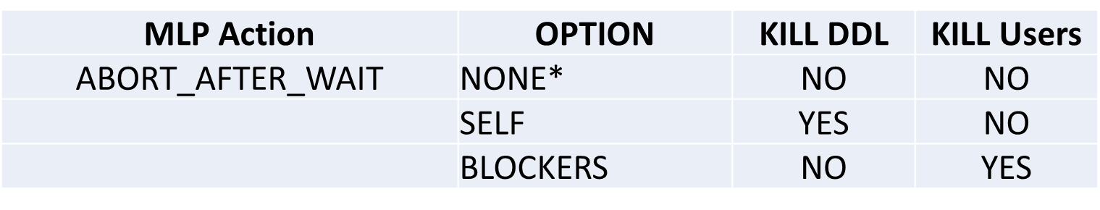
Online Operations in SQL Server 2014
Single Partition Online Index rebuild
Rebuild an index online for individual partitions – partition remains available
Optimizes availability, CPU, memory, disk space
Managing Lock Priority - for table partition SWITCH and Online Index Rebuild
Manage the Schema-Modification lock for partition SWITCH
Manage the Shared and Schema-Modification lock for Online Index Rebuild
Three manageability options for DDL:
**If, during wait times there are no blocking activities the operation will execute immediately.
Paweł Potasiński – dziś już była

Slide 10
In-memory in the data warehouse Data stored row-wise: Heaps, b-trees, key-value
“By using SQL Server 2012 In-Memory ColumnStore, we were able to extract about 100 million records in 2 or 3 seconds versus the 30 minutes required previously.“
–Atsuo Nakajima Asst Director, Bank of Nagoya
In-Memory Columnstore
Both memory and disk
Built-in to core RDBMS engine
Customer Benefits:
10-100x faster
Reduced design effort
Work on customers’ existing hardware
Easy upgrade; Easy deployment
Existing Tables (Partitions)
C1
C2
C3
C4
C5
C
6
Columnstore Index Representation
Needed columns
Notes:
When it came to design something for the data warehouse, Microsoft took the same in-memory “technology” from BI and designed it for the data warehouse. To do this, Microsoft built a memory-optimized columnstore index which will also organize data columnar wise. Furthermore, it was designed to work on any existing hardware implementation by ensuring you didn’t necessarily need all the data to fit into memory. When the query runs, SQL Server will automatically pick the most optimized index and will bring data into or out of memory on demand not requiring you to have a memory capacity that fits your entire dataset. This design gives you the performance gains by fully utilizing the hardware you have today.
This gives customers a great experience. It is an easy upgrade from previous versions to SQL Server 2012 and an easy deployment of in-memory by simply forming this index (takes minutes) using SQL Server Management Studio. Customers need not buy a separate, expensive, disconnected hardware appliance. It simply works with what you currently have.
And the results have been stunning. By turning on this option in SQL Server, customers have experienced 10-100X speed improvements. The unintended side effect was also allows customers not to worry about precisely tuning their SW and HW.

Slide 11
Updatable columnstore index
Table consists of column store and row store
DML (update, delete, insert) operations leverage delta store
INSERT Values
Always lands into delta store
DELETE
Logical operation
Data physically remove after REBUILD operation is performed.
UPDATE
DELETE followed by INSERT.
BULK INSERT
if batch < 100k, inserts go into delta store, otherwise columnstore
SELECT
Unifies data from Column and Row stores - internal UNION operation.
“Tuple mover” converts data into columnar format once segment is full (1M of rows)
REORGANIZE statement forces tuple mover to start.
Delta (row)
store
C1
C2
C3
C4
C5
C6
C1
C2
C3
C4
C5
C6
Column
Store
tuple mover
Paweł Potasiński – środa po lunchu

Slide 12
Resource pools
Represents physical resources of server
Can have one or more workloads assigned to pool
Pool divided into shared and non-shared
Pools control min/max for CPU/memory and now IOPS
CREATE RESOURCE POOL pool_name
[ WITH
( [ MIN_CPU_PERCENT = value ]
[ [ , ] MAX_CPU_PERCENT = value ]
[ [ , ] CAP_CPU_PERCENT = value ]
[ [ , ] AFFINITY {SCHEDULER = AUTO | (Scheduler_range_spec) | NUMANODE = (NUMA_node_range_spec)} ]
[ [ , ] MIN_MEMORY_PERCENT = value ]
[ [ , ] MAX_MEMORY_PERCENT = value ]
[ [ , ] MIN_IOPS_PER_VOLUME = value ]
[ [ , ] MAX_IOPS_PER_VOLUME = value ])
]
Łukasz Grala - środa

Slide 13
Delayed Durability in SQL Server 2014
New performance feature
Trades off durability for performance
Durability is potentially delayed, so there may be some data loss on server crash
Improves latency and (potentially) throughput
Tests with local storage show up to 30% perf gain in throughput
Particularly useful for IO subsystems with high latency, like in Windows Azure VM
Limitation with high level of throughput
Delayed durability in OPT-IN
Default remains full durability
Opt-in at database and transaction level
Availability of the feature
Works for all* user transactions local to a database (both disk-based and memory-optimized)
The following are always fully durable:
System transactions
Cross-database transactions
Change tracking transactions
Transactions that create a file in a FileTable
Leszek Kwaśniewski - wtorek

Slide 14
Incremental Statistics
Statistics are created and maintained on a per partition basis using the INCREMENTAL option.
Allow for partitioned indexes with partition alignment to base table to now have incremental statistics
Can be quite beneficial in terms of queries across large data-sets or within a particular partition to get more accurate statistics distributions
Notes:
Statistics created with indexes that are not partition-aligned with the base table.
Statistics created on AlwaysOn readable secondary databases.
Statistics created on read-only databases.
Statistics created on filtered indexes.
Statistics created on views.
Statistics created on internal tables.
Statistics created with spatial indexes or XML indexes.

Slide 15
New CE (Cardinality Estimation)
Enabled with DB compatibility level of 120, run side-by-side with the previous version of CE
May cause significant plan change
New CE in query plan
Look for CardinalityEstimationModelVersion = 120 in XML query plan
Some key changes
Relaxing independence assumption
Ascending key modifications
Join changes
Maciej Pilecki i Paweł Potasiński - środa
Notes:
A query with multiple predicates combined with “and”:SELECT *FROM CarsWHERE Make = „Honda‟ AND Model = „Civic‟ 1000 Rows. 200 Hondas, 50 Civics.
Old CE (independence)
New CE (exponentialbackoff)
What is Ascending Key Problem? Newly inserted data are out of the range in histogram
 How is it solved in new CE? Always assume the queried value(s) exist in the data set Estimate cardinality using average frequency Same heuristics also apply to missing values in sample statistics
Equijoin with one or more predicates Take the lesser of the Distinct Value Counts between two inputs(10) Multiply by average frequencies from both inputs
Non-equijoin Take the cardinality of the larger side of the inputOverpopulated Primary Key: Boost joinestimates in specific scenarios

Slide 16
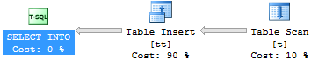
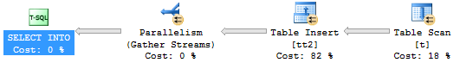
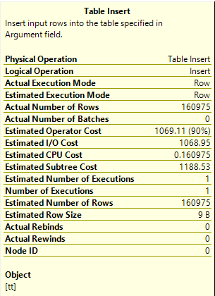
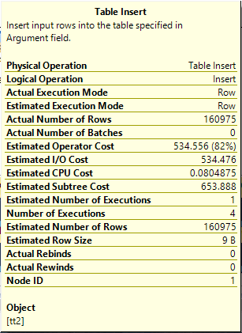
Parallel select into
Compat level = 110
CPU time = 3156 ms, elapsed time = 19255 ms.
Compat level =120
CPU time = 4259 ms, elapsed time = 14532 ms.
Damian Widera - środa

Slide 17
Increased Readable Secondary Availability
SQL Server 2014: read workloads not impacted during network failures.. or primary down.. or cluster quorum loss..
Readable secondaries remain available during “Resolving” state
Requires direct connections to readable secondaries (Read-only routing not supported yet)
Replica state and last commit time available in DMV/Dashboard

Slide 18
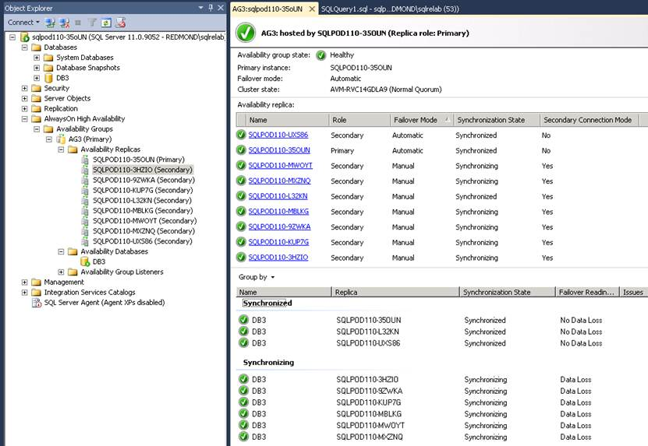

Slide 19
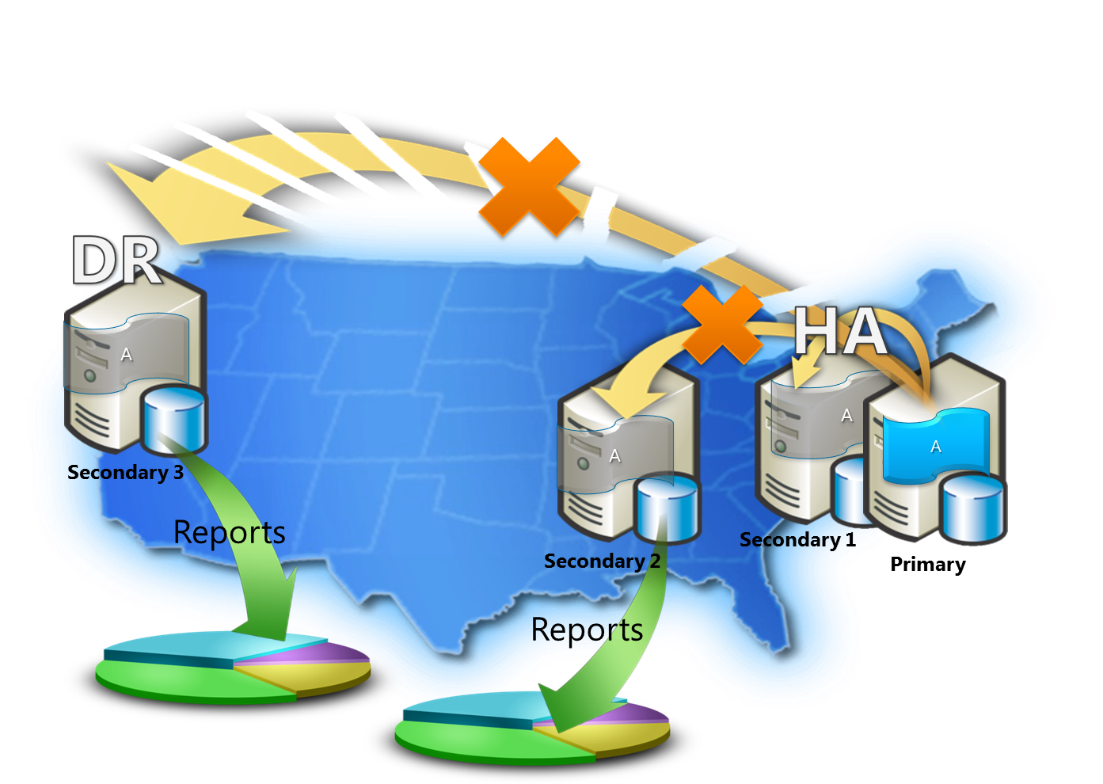


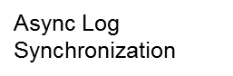
Availability Groups Readable secondaries
Sync Log
Synchronization

Slide 20
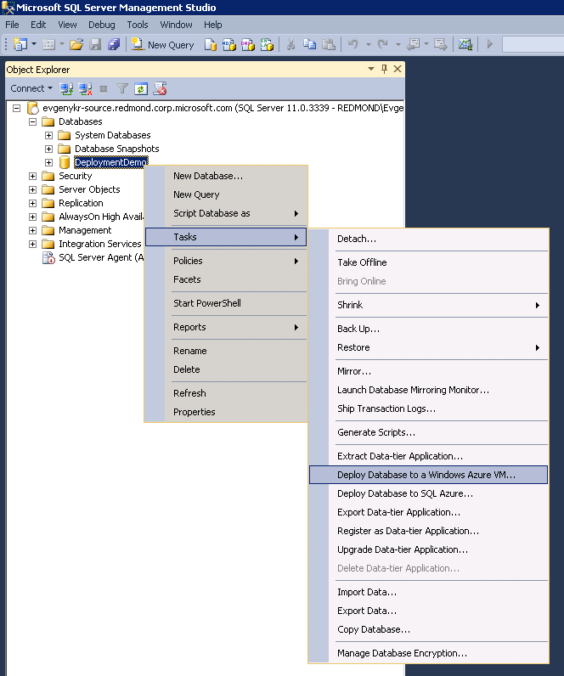
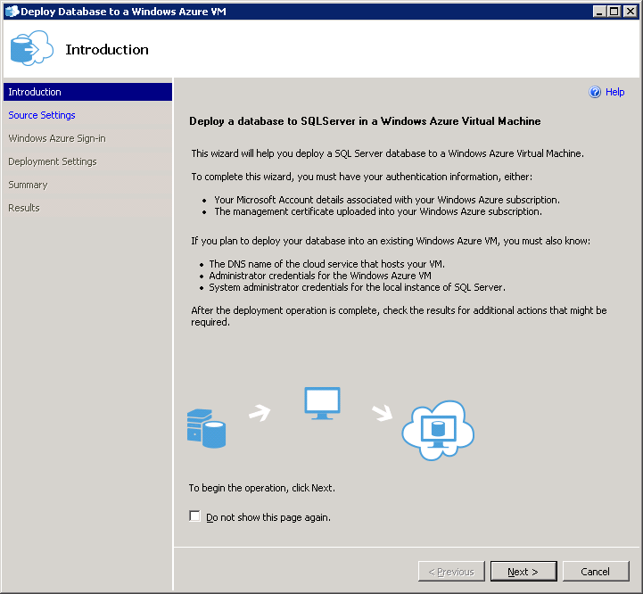

Migracja baz danych SQL Server do VM
Nowy kreator migracji
Łatwiejsza migracja „on-premises SQL Server” do Windows Azure VM
Kreator migracji do chmury (VM)
SQL Server na Windows Azure VM
Idealne dla istniejących aplikacji oraz procesu tworzenia i testowania aplikacji
Pełna funkcjonalność SQL Server
Pełna kontrola VM
Windows Azure SQL Database Service
Idealne dla zmiennego zapotrzebowania w zasoby
Dynamiczne skalowanie DB
Brak uaktualnień OS i silnika DB
Wysoka dostępność (99.9% SLA)
DB

Slide 21
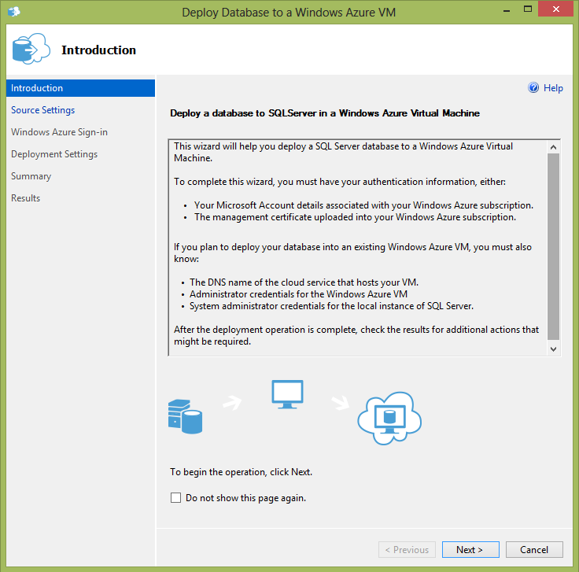
Wdrożenie baz danych SQL Server do Windows Azure VM
Nowy kreatotor wdrażania SQL Server na Windows Azure VM
Możliwość utworzenia Windows Azure VM
Zalety
Prosty w użyciu
Nie wymaga znajomości Windows Azure

Slide 22

Hybrydowe rozwiązania z chmurą
Simplified cloud backup
Manual or automatic
At an instance level with point-in-time restore
Measures database usage patterns to set backup frequency
Redukacja CAPEX i OPEX z „cloud DR”
Run backups
Windows Azure
Run BI reports
Cloud disaster recovery
Szybki DR(niskie RTO)
Łatwe do wdrożenia i zarządzania
Secondary replica
Asynchronous commit
VPN tunnel (Windows Azure Virtual Network)
On-premises network
Extend on-premises apps
Elastycznośc chmury
Globalny zasięg
Lepsza izolacja aktywów
Domain controller
Synchronous commit
Primary replica
Secondary replica
Notes:
Talk track in slide 23

Slide 23



Typowa konfiguracja
Windows Azure
On-Premises

Slide 24
Definicje indeksów inline
Możliwość dodawania indeksów w ramach składni CREATE TABLE
Wspierane: WITH FILLFACTOR/ON FILEGROUP/WITH DATA_COMPRESSION
Niewspierane: UNIQUE INDEX/WITH INCLUDE/WHERE
Cache-owanie tabel tymczasowych
Możliwość tworzenia indeksów inline na zmiennych tablicowych

Slide 25
DEMO – indeksy inline
Tworzenie indeksów inline
Cache-owanie tabel tymczasowych
Zmienne tablicowe

Slide 26
Nowe uprawnienia
CONNECT ANY DATABASE (server scope) | Uprawnienie do łączenia się ze wszystkimi bazami danych – włącznie z tymi, które zostaną utworzone w przyszłości
IMPERSONATE ANY LOGIN (server scope) | Uprawnienie do przełączania do kontekstu każdego loginu
SELECT ALL USER SECURABLES (server scope) | Uprawnienie do odczytu danych we wszystkich obiektach, we wszystkich bazach danych do których login ma dostęp
ALTER ANY DATABASE EVENT SESSION (database scope) | Uprawnienie nadawane użytkownikom/ rolom bazodanowych, do modyfikacji sesji XE
Nowe uprawnienia = lepsze przydzielanie uprawnień podmiotom zabezpieczeń nie należącym do sysadmin

Slide 27
DEMO - Uprawnienia
Przykłady scenariuszy użycia nowych uprawnień
Nowak jest administratorem ale ma nie mieć dostępu do danych w żadnej z baz
Kowalski – audytor – ma mieć dostęp do danych we wszystkich bazach ale nie może mieć uprawnień administracyjnych

Slide 28
Szyfrowanie kopii zapasowych
Podnosi bezpieczeństwo kopii zapasowych, przechowywanych poza instancją (np. usługi chmurowe)
Klucze szyfrujące mogą być przechowywane lokalnie, podczas gdy kopia zapasowa - w chmurze. Szyfrując kopię zapasową nie musimy jednocześnie szyfrować całej bazy danych (np. Transparent Data Encryption)
Wspierane algorytmy:
AES 128
AES 192
AES 256
3DES

Slide 29
Szyfrowanie kopii zapasowych SKŁADNIA
BACKUP DATABASE <database_name>
TO <backup_device> = <path>
--Encryption Options
WITH ENCRYPTION (
ALGORITHM = { AES_128 | AES_192 | AES_256 | TRIPLE_DES_3KEY } ,
{ SERVER CERTIFICATE = Encryptor_Name |
SERVER ASYMMETRIC KEY = Encryptor_Name }
);
RESTORE – bez zmian

Slide 30
Szyfrowanie kopii zapasowych ZMIANY W WIDOKACH SYSTEMOWYCH
msdb.dbo.backupset
msdb.dbo.backupmediaset
backup_set_id | name | key_algorithm | encryptor_thumbprint | encryptor_type
3 | Full Backup | NULL | NULL | NULL
4 | Full Backup | aes_256 | 0x00B1BD62DAA0196 | CERTIFICATE
media_set_id | is_password_protected | is_compressed | is_encrypted
3 | 0 | 1 | 0
4 | 0 | 1 | 1

Slide 31
Szyfrowanie kopii zapasowych DODATKOWE INFO
Edycje wspierające szyfrowanie kopii zapasowych (Express/Web tylko odtwarzanie):
Enterprise
Business Intelligence
Standard
Nie można odtworzyć zaszyfrowanej kopii zapasowej na wcześniejszej wersji SQL Server
Każda zaszyfrowana kopia zapasowa musi być umieszczona w osobnym pliku („Appended backup is not supported”)
Szyfrowanie kopii zapasowych dostępne w:
T-SQL
SSMS (okno „Backup Database” oraz Maintenance Plan Wizard)
PowerShell
C:\PS>$encryptionOption = New-SqlBackupEncryptionOption -Algorithm Aes256 -EncryptorType ServerCertificate -EncryptorName "BackupCert„ C:\PS>Backup-SqlDatabase -ServerInstance . -Database "MyTestDB" -BackupFile "MyTestDB.bak" -CompressionOption On -EncryptionOption $encryptionOption
Więcej informacji o kopiach zapasowych w error logu - dodatkowe wpisy z info o liczbie zapisanych stron danych i czasie trwania operacji BACKUP DATABASE
Nowa opcja konfiguracyjna instancji: sp_configure ‘backup checksum default’ (is_dynamic = 1, is_advanced = 0)

Slide 32
DEMO - Szyfrowanie kopii zapasowych

Slide 33
Buffer Pool Extension
pozwala użyć dysku SSD (jak i każdego innego dysku) – jako rozszerzenia Buffer Pool.
Rozmiar pliku BPE:
Maksymalny – 32 * wielkość posiadanej pamięci dostępnej dla SQL Server
Zalecany – 16 * wielkość pamięci
BPE dzieli buffer pool na dwie warstwy:
Level1 - pamięć operacyjna - zawierająca czyste i brudne strony danych
Lavel2 - umieszczony na dysku, zawierający tylko czyste strony
Best practice: unikaj włączania/wyłączania BPE na serwerze produkcyjnym. Dodatkowo pamięć na SSD nie jest zwalniana bez restartu instancji.

Slide 34
Buffer Pool Extension SKŁADNIA
ALTER SERVER CONFIGURATION SET BUFFER POOL EXTENSION ON (
FILENAME = 'E:\DB_Cache\SQL2014.BPE',
SIZE = 10 GB
);
ALTER SERVER CONFIGURATION SET BUFFER POOL EXTENSION OFF;

Slide 35
DEMO - BPE

Slide 36
Backup w Windows Azure
SQL Server wspiera backup i restore z/na Windows Azure Blob storage (UI, T-SQL, PowerShell)
Elastyczność, trwałość (3-kopie geo-DR)
Nie ma zarządzania kopiami zapasowymi i nośnikami
Brak nakładów na sprzęt
CREATE CREDENTIAL mystoragecred
WITH IDENTITY = ‘mystorage',
SECRET = ‘<your storage access key>
BACKUP DATABASE mydb TO URL ='https://mystorage.blob.core.windows.net/backup-container/mydb-20130411.bak'
WITH CREDENTIAL = ‘mystoragecred', FORMAT, COMPRESSION, STATS = 5,
MEDIANAME = ‘mydb backup 20130411', MEDIADESCRIPTION = 'Backup of mydb'

Slide 37

Backup to Windows Azure
Windows Azure VM
Windows Azure storage
On-premises server
On-site/off-site storage costs
Device management costs
Windows Azure Blobs
Box
Near “bottomless” storage
Off-site, geo-redundant
No provisioning
No device management
Media safety (decay-free)
Remote accessibility
WA
XDrives limited to 1 terabyte
Max 16 drives
Manage drives and policy
Notes:
You can use the Transact-SQL ALTER TABLE...SWITCH statement to quickly and efficiently transfer subsets of your data in the following ways:
Assigning a table as a partition to an already existing partitioned table.
Switching a partition from one partitioned table to another.
Reassigning a partition to form a single table.

Slide 38
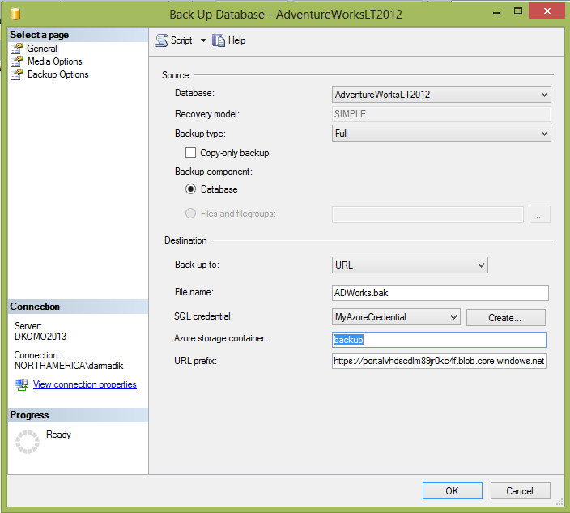
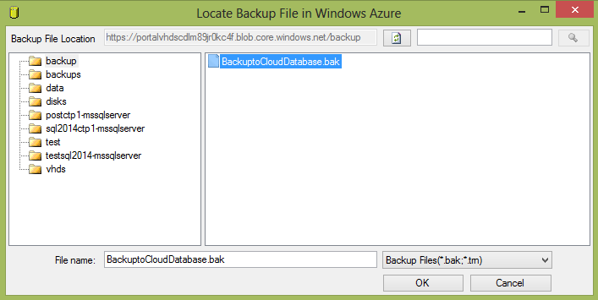
Backup to Windows Azure
Backup GUI
Restore GUI

Slide 39
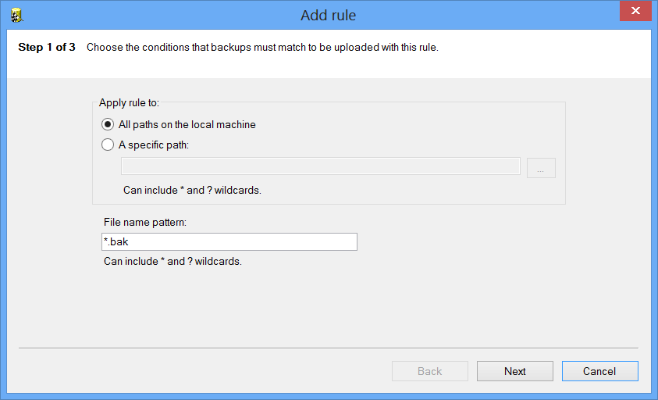
Backup to Windows Azure Tool
What is it?
Stand-alone Tool that adds backup to Windows Azure capabilities and backup encryption to prior versions of SQL Server
Benefits
One Cloud Backup strategy across prior versions of SQL Server including 2005, 2008, and 2008 R2
Adds backup encryption to prior versions, locally or in the cloud
Takes advantage of backup to Azure
Easy configuration

Slide 40
Zarządzalny backup do Azure
Co to jest?
Agent zarządzający i automatyzujący SQL Server backup
Główne korzyści
Łatwe zarządzanie
Okres przechowywania
Zakres instancji, bazy danych, lub częściowy
Zalety Azure
Z natury przechowywanie poza miejscem działania
Geo-redundantny
Minimalny koszt magazynowania
Brak zarządzania sprzętem
Przykład:
EXEC smart_admin.sp_set_db_backup
@database_name='TestDB',
@storage_url=<storage url>,
@retention_days=30,
@credential_name='MyCredential',
@enable_backup=1

Slide 41
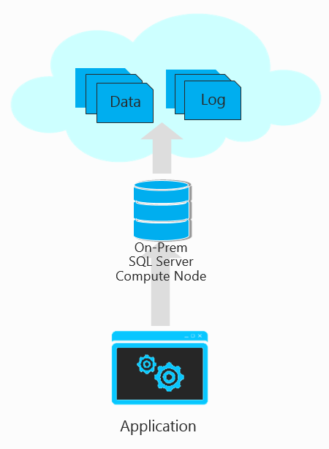
SQL Server data and log files w Windows Azure storage
Co to jest?
Możliwość przeniesienia plików danych i dziennika logów do Windows Azure Storage, utrzymując węzeł obliczeniowy „SQL Server on-premises”
Wsparcie do Transparent Data Encryption (TDE)
Główne korzyści
Po stronie aplikacji, klienta nie wymaga żadnych zmian
Scentralizowane kopie danych i plików dziennika logów
Nieograniczone składowanie w Azure Storage (wraz z HA, SLA, geo-DR)
Bardzo bezpieczne ponieważ wykorzystuje szyfrowanie TDE, gdzie klucze są składowane on-premises
Szybkie odtwarzanie bazy danych poprzez podłączenie

Slide 42
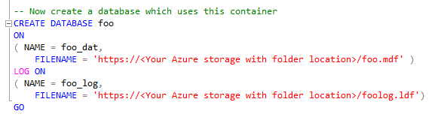
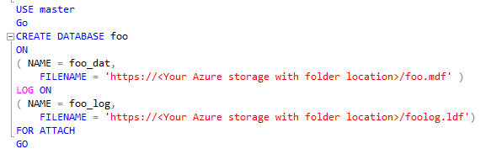
SQL Server data and log files w Windows Azure storage
Składnia tworzenia bazy danych (bez zmian)
Odtwarzanie bazy danych poprzez podłączenie

Slide 43
Nowości w Standard Edition
Dostępny SSD Buffer Pool Extension
Maximum RAM
dostępne Max Memory jest 128GB (było 64GB)
Delayed Durability
COMMIT transakcji jest asynchroniczny
Zarządzany na poziomie transakcji, lub bazy danych
Notes:
http://msdn.microsoft.com/en-us/library/ms143760(v=sql.120).aspx
http://msdn.microsoft.com/en-us/library/cc645993(v=sql.120).aspx
http://msdn.microsoft.com/en-us/library/dn449490(v=sql.120).aspx

Slide 44
Podsumowanie
Warto poznać i pracować z SQL Server 2014

Slide 45
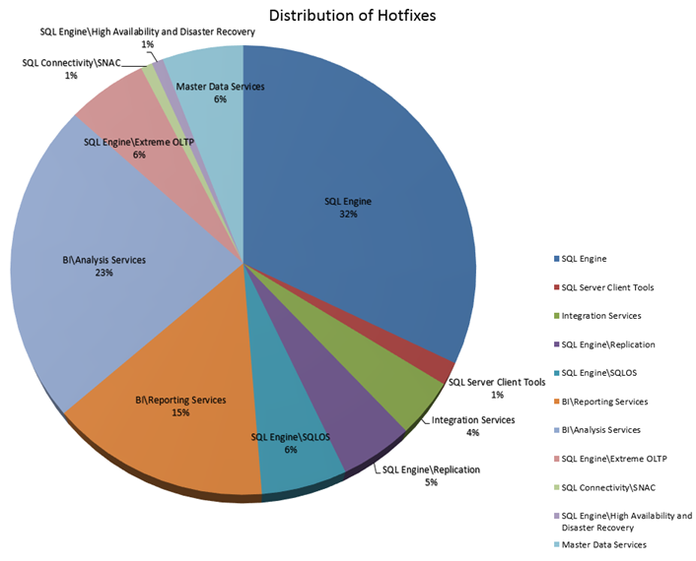
Podsumowanie – SQL Server 2014 Cumulative Update 1
121 Resolved Issues
80 Unique Customer Requests

Slide 46

NASI SPONSORZY I PARTNERZY
Organizacja: Polskie Stowarzyszenie Użytkowników SQL Server - PLSSUG

